Slide 1

Credit Card Fraud Detection
By Sudhansu Sekhar Pradhan

Slide 2



PROBLEM STATEMENT
The main objectives of this project are to:
Develop an accurate and efficient fraud detection system.
Need a method that is simple and fast detecting most frauds misclassifying the least.
Utilize machine learning algorithms to improve fraud detection accuracy.

Slide 3
TIMELINE
Credit Card Data Collection
Kaggle
Data Pre Processing
Use of Python Library Pandas
Visuals Creation by using Python Library Mat.plot.lib
Regression Model
Logistic Regression Model, Decision Tree Classifier, Random Forest Classifier
Data Analysis
Evaluation

Slide 4



CHALLENGES FACED
The main challenge in credit card fraud detection are:
Huge Size of Data : millions of transactions are processed everyday.
Imbalanced data set : more than 99% transactions are legitimate
Adaptive techniques : fraudsters change style of bluff detection system
Availability of data : bank doesn’t reveal customer information.

Slide 5
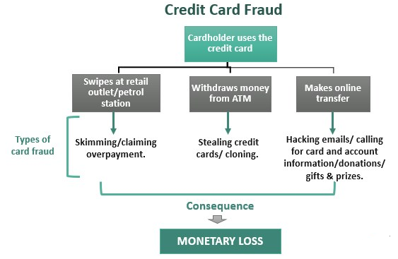
INTRODUCTION
Credit Card Fraud Detection relies on the automatic analysis of recorded transactions.
Credit card fraud is a significant issue that can have severe financial consequences. This presentation focuses on using machine learning techniques to detect credit card fraud in real-time.
What are Credit Card Fraudulent Transactions ?
Credit Card Frauds may happen in Variety of ways :
Lost Card – Used by the person who finds it
Card number, Pin etc. overseen by next person
Fake Phone calls Convincing to disclose details
Hacking from bank Accounts or other repositories

Slide 6

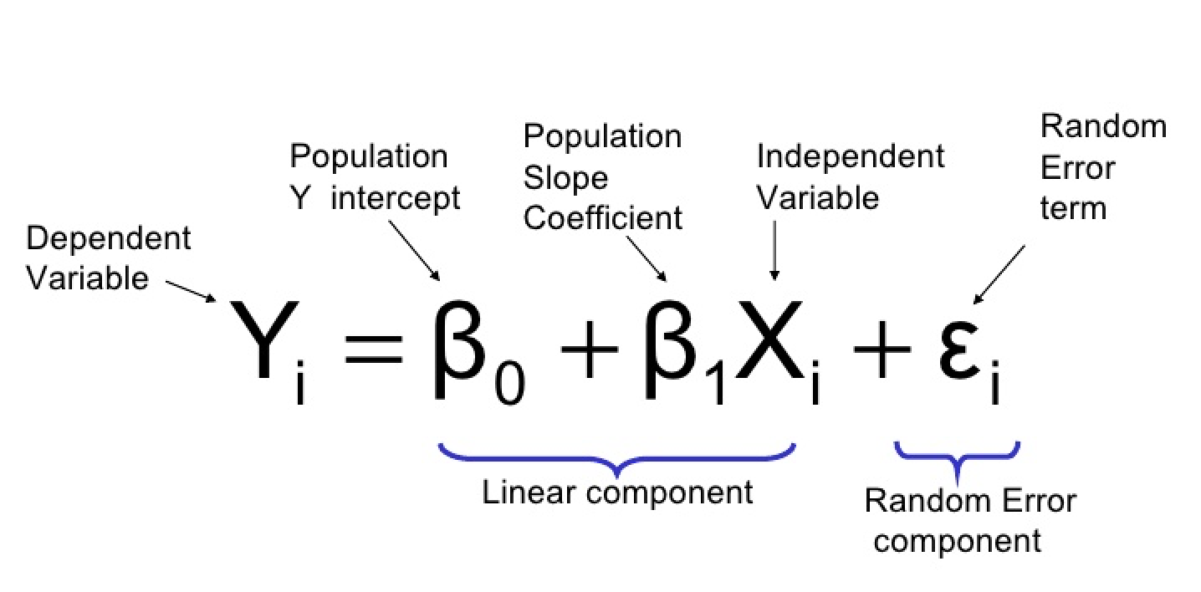
Logistic Regression
Logistic regression is a supervised machine learning algorithm mainly used for classification tasks where the goal is to predict the probability that an instance of belonging to a given class or not.
It is a kind of statistical algorithm, which analyze the relationship between a set of independent variables and the dependent binary variables.
It is a powerful tool for decision-making.
For example email spam or not.

Slide 7
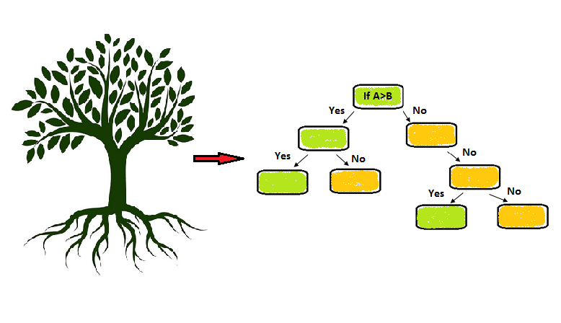
Decision Tree Classifier
A decision tree is one of the most powerful tools of supervised learning algorithms used for both classification and regression tasks.
It builds a flowchart-like tree structure where each internal node denotes a test on an attribute, each branch represents an outcome of the test, and each leaf node (terminal node) holds a class label.
The goal is to find the attribute that maximizes the information gain or the reduction in impurity after the split.

Slide 8
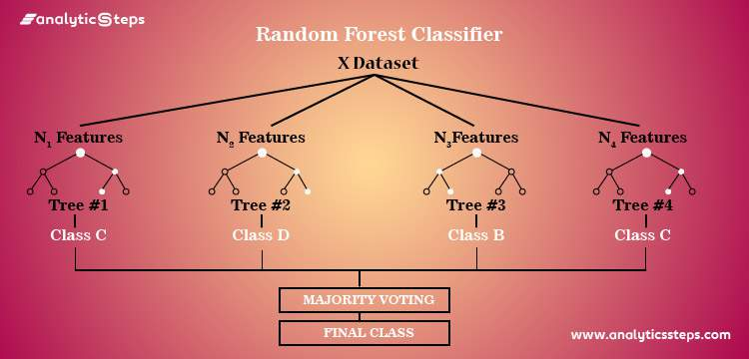
Random Forest Classifier
We know that a forest comprises of numerous trees, and the more trees more it will be robust.
Similarly, the greater the number of trees in a Random Forest Algorithm, the higher its accuracy and problem-solving ability.
Random Forest is a classifier that contains several decision trees on various subsets of the given dataset and takes the average to improve the predictive accuracy of that dataset.
It is based on the concept of ensemble learning which is a process of combining multiple classifiers to solve a complex problem and improve the performance of the model.

Slide 9
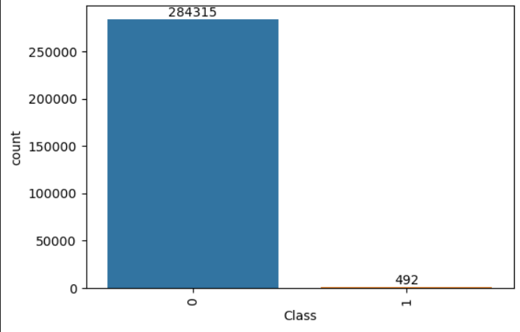
Distribution of Data
We are having 284807 Credit Card Transactions.
It is important to divide the data into Legitimate and Fraudulent Data.
Legitimate – 284315, Fraudulent - 492

Slide 10
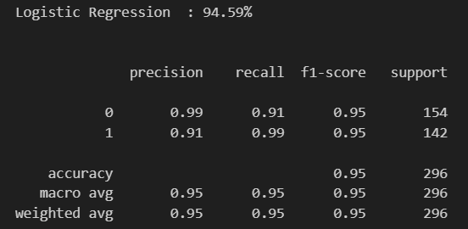
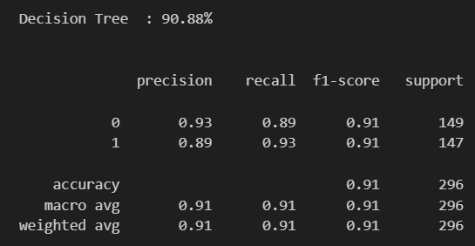

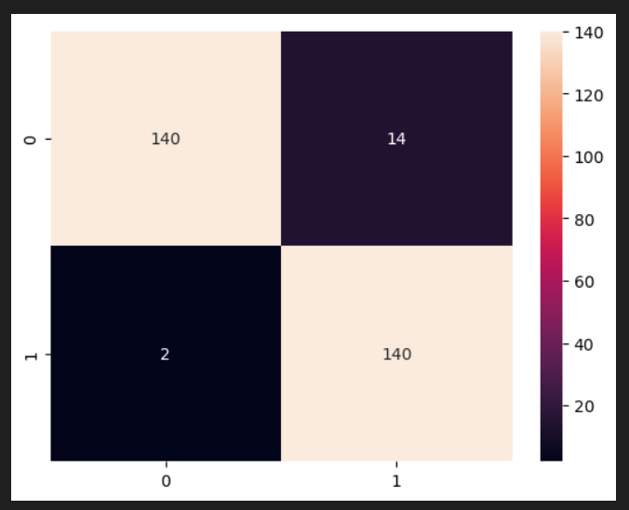
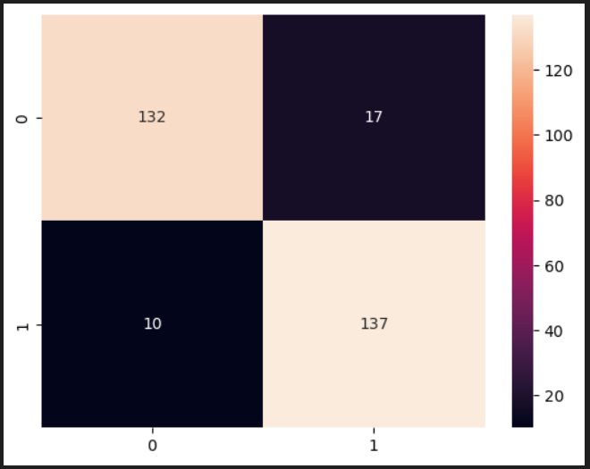
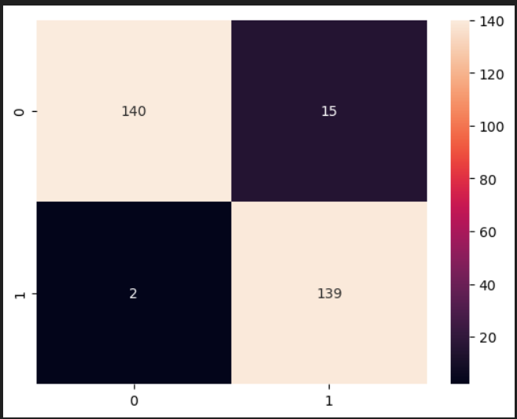
Evaluation

Slide 11

SUMMARY
The use of machine learning techniques for credit card fraud detection is highly beneficial.
This project highlights the importance of accurate and efficient fraud detection systems in mitigating financial losses.
Future applications and extensions of this project are worth exploring.

Slide 12

Thank You

